Slide 1
A Transaction-Friendly Dynamic Memory Manager for Embedded Multicore Systems
Maurice Herlihy
Joint with
Thomas Carle , Dimitra Papagiannopoulou
Iris Bahar , Tali Moreshet

Slide 2
Modern Embedded Systems
now many core, distributed memory
Parallel data structures
Locks don’t scale
Transactions do (más o menos)

Slide 3
Dynamic Memory Management
Software’s « oldest profession>
Usually provided by OS/Libraries
For parallel data structures
on embedded platforms
with HTM

Slide 4
High-End Embedded Systems
simplicity
small memory footprint
resource needs
roughly known in advance
but not always exactly

Slide 5
Dynamic Memory Management
Heap is linked list or binary tree
Applications explicitly malloc() and free() memory
Size: 16 bytes
Start: 0x0800000
Size: 64 bytes
Start: 0x0800100

Slide 6
Principles of dynamic memory management
Allocate a 32-byte chunk
Size: 16 bytes
Start: 0x0800000
Size: 64 bytes
Start: 0x0800100
Too small
Large enough

Slide 7
Dynamic Memory Management
Allocate a 32-byte chunk
Size: 16 bytes
Start: 0x0800000
Size: 64 bytes
Start: 0x0800100

Slide 8
Dynamic Memory Management
Allocate a 32-byte chunk
Size: 16 bytes
Start: 0x0800000
Size: 64 bytes
Start: 0x0800100
Size: 32 Bytes
Start: 0x0800100
Size: 32 Bytes
Start: 0x0800120

Slide 9
Principles of dynamic memory management
Allocate a 32-byte chunk
Size: 16 bytes
Start: 0x0800000
Size: 64 bytes
Start: 0x0800100
Size: 32 Bytes
Start: 0x0800100
Size: 32 Bytes
Start: 0x0800120

Slide 10
Principles of dynamic memory management
Allocate a 32-byte chunk
Size: 16 bytes
Start: 0x0800000
Size: 32 Bytes
Start: 0x0800120
Freeing is similar …
Size: 32 Bytes
Start: 0x0800100

Slide 11
Dynamic Memory Management
is a concurrent data structure problem
steps must be atomic

Slide 12
Fast Path
Thread-local pools
successful malloc() and free() need no synchronization
Calls happen inside transaction
Speculative allocation can speed up the execution

Slide 13
Slow Path
If local pool exhausted,
must allocate from shared heap
Allocate within transaction
means more conflicts
Instead:
abort current transaction
allocate fresh local pool
restart transaction

Slide 14
Benefits
Transactions have smaller footprints
Disentangles
application
shared heap management
Transactions more likely to commit

Slide 15
Transaction-friendly memory management
At application startup:
One thread initializes the heap
Each thread allocates its own local pool

Slide 16
Transaction-friendly dynamic memory management
Commit allocation transaction
Free remaining pool and allocate fresh pool
Enter allocation transaction
Abort transaction
no
Next
Instruction ?
malloc()
Enough memory?
Enter transaction
Allocate from local pool
Return allocated chunk
yes

Slide 17
Transaction-friendly dynamic memory management
Next
Instruction ?
free()
Enter transaction
Free to local pool

Slide 18
Evaluation
STAMP Vacation benchmark
1, 2, 4, 8 and 16 cores
Local pools large enough so no refill needed
Tested:
transactional with local pools
lock-based with local pools
lock-based without local pools

Slide 19
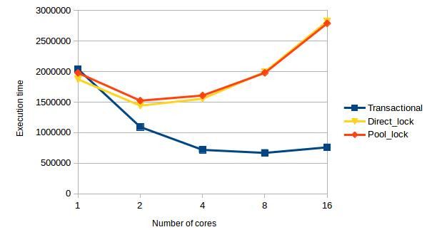
Evaluation
Vacation benchmark (Normal run)
worse
better

Slide 20
Evaluation (2)
Vacation benchmark (Refill mechanism on one core)
8 cores
local pool sizes: 64, 128, 256, 512, 1024, 2048 bytes
Transactional synchronization

Slide 21
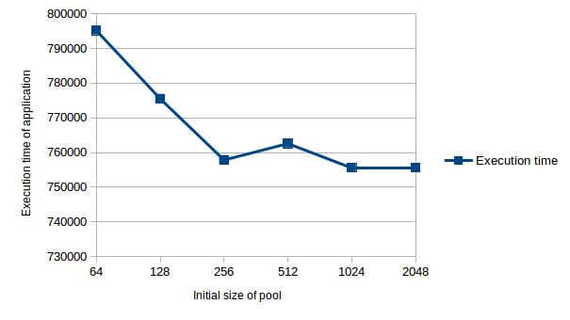
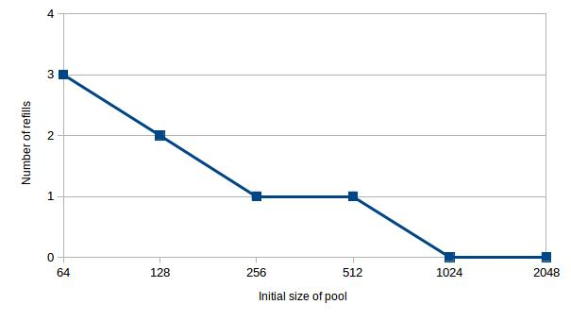
Evaluation (2)
Vacation benchmark (Refill mechanism on one core)
Notes:
First of all, starting at 1024 bytes in the initial pool, there is no need for refills: the executions with 1024 and 2048 bytes are exactly the same (same timings and execution traces).
For 64, 128 and 256 bytes, we see a linear decrease, which is what we would expect, since the number of refills also decreases linearly.
For 256 and 512 bytes, both necessitate 1 refill. This refill happens earlier in the 256 bytes case. The refill in the 512 bytes cases happens at a time such that it leads to additional conflicts and aborts when the execution resumes, hence the timing overhead compared to 256 bytes.
Finally, the gain between 256 bytes (1 abort) and 1024 (0 abort) is not as big as we would expect when looking at the linear decrease at the start of the figure. I believe this is due to the fact that the abort overhead on the core is partially covered by regular conflicts/aborts on other cores.

Slide 22
Evaluation (3)
Vacation benchmark (Refill mechanism on all but one core)
8 cores
local pool sizes: 64, 128, 256, 512, 1024 or 2048 bytes
Transactional synchronization

Slide 23
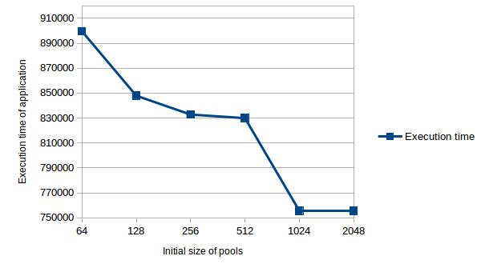
Evaluation (3)
Vacation benchmark (Refill mechanism on all but one core)
worst case: 20% increase in execution time
« Wall » between 512 and 1024 bytes: refills may induce additional conflicts
Notes:
In the worst case (64 bytes), there is a 16% overhead in the program’s execution time, due to the multiple refills on the various cores, and to the additional regular conflicts that they produce.
One can see this as huge, but we must keep in mind that choosing 64 bytes for each core when we really need 1024 means an error by a factor of 16 when choosing the size, which is also big.
Here we see the importance of designing well the initial size of the pools.
We also see that our mechanism can (at the expense of some performance – no free lunch) provide extra flexibility to the system. So for systems when it is only possible to make conservative predictions on the required size of the pool, or if you do not want to predict it because it would require (time and money) expensive static analysis, it can be interesting to consider this tradeoff: sacrifice a bit of performance for greater flexibility and/or less static analysis during the design phase of the system.
Also, in combination with future work (memory stealing and/or returning some memory to the heap at some points in the execution), this extra flexibility allows systems to run applications with less embedded memory than with a static allocation scheme.

Slide 24
Conclusions
Dynamic memory management for Embedded TM
Results
Better than locking, in-transaction malloc
More flexible than static allocation
Future work
More benchmarks
Explore new fallback reprovision strategies
Memory stealing between threads

