Slide 1
Dynamic Verification for Hybrid Concurrent Programming Models
Erdal Mutlu
Koc University, Istanbul
Vladimir Gajinov, Dr. Adrian Cristal,
Dr. Serdar Tasiran and Dr. Osman Unsal
Euro-TM Short Term Scientific Mission
Barcelona Supercomputing Center
DMTM – January 22, 2014

Slide 2
Outline
Hybrid concurrent programming models
Motivation
Dynamic verification
Our proposed solution
Conclusion
Ongoing Work

Slide 3
Hybrid Concurrent Programming Models
Concurrent programming models
Shared memory: Lock based, Transactional Memory
Message-passing
Data-flow
Hybrid concurrent programming models
Data-flow + Shared memory
Atomic DataFlow (ADF) programming model
OpenMP 4.0
Intel TBB-Flow graph
Notes:
-> With emerge of the multicore systems, concurrent programming models are proposed to make development easier
-> But now with the advances on the multicore systems only one model is not enough for developers

Slide 4
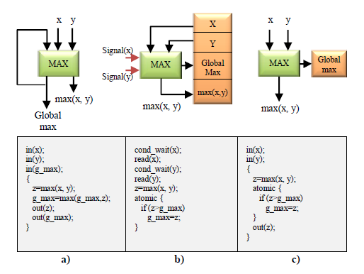
Atomic DataFlow (ADF) Programming Model
Data-flow constructs with Transactional Memory (TM) support

Slide 5
Motivation
New programming models give rise to new kinds of concurrency bugs
Combination of models
Programmer visible non-determinism
Verification/Testing capabilities are required

Slide 6
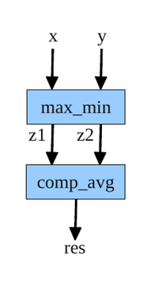
Motivating Example
Consider two tasks:
max_min: compute the maximum and minimum values from two input streams while updating a global min and max
comp_avg: comparing the average values of global max and min with the input values and returning the bigger one.

Slide 7
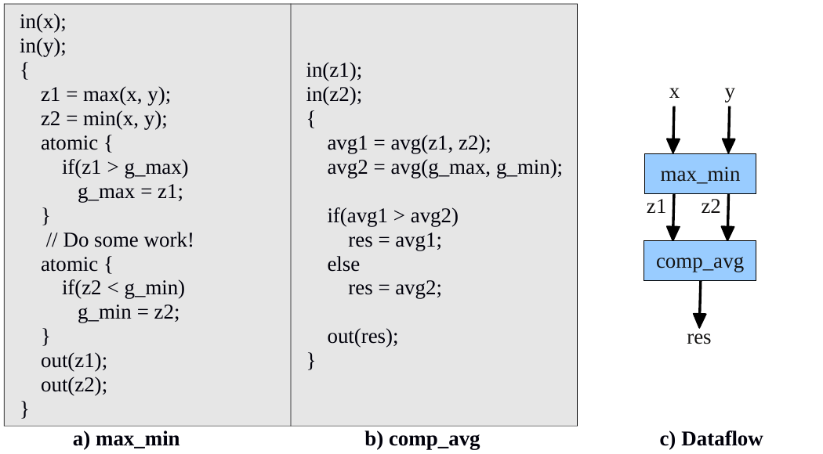
Motivating Example
Read old value
Notes:
-end: what can be done to avoid or detect this kind of buggy behaviors before it is too late

Slide 8
Dynamic Verification for Concurrent Systems
Behavior Exploration
Randomized Exploration
Probabilistic Concurreny Testing (PCT)
Disciplined randomization of thread schedules
Probabilistic guarantees
Systematic Exploration
CHESS
Systematically enumerating thread interleavings
Reliably reproducing concurrent executions

Slide 9
Probabilistic Concurrency Testing (PCT)
Bug Depth: the number of ordering constraints a schedule has to satisfy to find the bug
Finds concurrency bugs in every run of the program
With reasonably-high probability
Scalable
In the no. of threads and program size
Effective
Bugs in IE, Firefox, Office Communicator, Outlook, …
Bugs found in the first few runs

Slide 10
Dynamic Verification for Hybrid Systems
Current verification techniques lack:
Knowledge about different models
Transactional memory (TM)
Dataflow
Programmer visible non-determinism
We propose:
Randomized exploration for hybrid programming model
Invariant monitoring mechanism

Slide 11
Randomized Behavior Exploration for ADF
Priority based scheduling
Assign random priorities to enabled tasks
Priority change points
Assign random priority change points before and after atomic blocks
Schedule tasks by honoring priorities
Check invariants at each step of execution

Slide 12
Randomized Exploration for ADF
P:3
P:4
P:4
max_min1
max_min2
max_min2
Assign priorities (1-N)
Assign priority change point (depth = 1)
Schedule task honoring priorities
Run max_min2 to completion and enable comp_avg tasks
Assign new priorities
Run max_min1 until priority change point
Run comp_avg1
z1 = max(x,y);
z2 = min(x,y);
z1 = max(x,y);
z2 = min(x,y);
z1 = max(x,y);
z2 = min(x,y);
atomic{
if(z1>g_max)
g_max = z1;
}
atomic{
if(z1>g_max)
g_max = z1;
}
atomic{
if(z1>g_max)
g_max = z1;
}
P : 0
//do local updates
//do local updates
//do local updates
atomic{
if(z2<g_min)
g_min = z2;
}
atomic{
if(z2<g_min)
g_min = z2;
}
atomic{
if(z2<g_min)
g_min = z2;
}
P:2
P:1
comp_avg1
comp_avg1
comp_avg2
comp_avg2
avg1 = avg(z1,z2);
avg2 = avg(g_max,g_min);
if(avg1 > avg2)
res = avg1;
else
res = avg2;
avg1 = avg(z1,z2);
avg2 = avg(g_max,g_min);
if(avg1 > avg2)
res = avg1;
else
res = avg2;
avg1 = avg(z1,z2);
avg2 = avg(g_max,g_min);
if(avg1 > avg2)
res = avg1;
else
res = avg2;
Read old value
avg1 = avg(z1,z2);
avg2 = avg(g_max,g_min);
if(avg1 > avg2)
res = avg1;
else
res = avg2;
Notes:
Invariant checking mechanism

Slide 13
Conclusion
New hybrid programming models → new kinds of races
We proposed:
Randomized testing capabilities
with probabilistic guarantees
Invariant monitoring mechanism

Slide 14
Ongoing Work
Evaluation
Dwarf benchmarks
Game engine
Probabilistic guarantee analysis
Record and replay capabilities

Slide 15
Thank you!
Questions?

Slide 16
Probabilistic Concurrency Testing (PCT)
Bug Depth: the number of ordering constraints a schedule has to satisfy to find the bug.
PCT is a randomized scheduling algorithm with a good probabilistic guarantee to find bugs of low depth

Slide 17
PCT Algorithm
Inputs: n: estimated bound on the number of threads
k: estimated bound on the number of steps
d: target bug depth
// 1. assign random priorities >= d to threads
for t in [1…n] do priority[t] = rand() + d;
// 2. chose d-1 priority change points at random
for i in [1...d) do lowering[i] = rand() % k;
steps = 0;
while (some thread enabled) {
// 3. Honor thread priorities
Let t be the highest-priority enabled thread;
schedule t for one step;
steps ++;
// 4. At the ith lowering point, set the priority to i
if steps == lowering[i] for some i
priority[t] = i;
}

