Slide 1
Exploiting Off-the-Shelf Virtual Memory Mechanisms to Boost Software Transactional Memory
Amin Mohtasham, Paulo Ferreira and João Barreto
Email: amohtasham@gsd.inesc-id.pt

Slide 2
Multicore revolution
Chip-multiprocessors are mainstream hardware
We must effectively program these systems

Slide 3
Lock-based methods
Parallel Programming with traditional locks is difficult
There is a trade-off between complexity and performance

Slide 4
Software Transactional Memory
Software Transactional Memory is:
Easy to use
Portable
Not limited by hardware capacity

Slide 5
The dark side of STM
STM has more sequential overhead than HTM
How can we alleviate this overhead?
Notes:
But STM has a dark side

Slide 6
A typical STM read operation
here comes the overhead
Thread#1
Physical Memory
readTx(X)
if isConsistent() then
read(X)
X=10
Notes:
To answer this question lets consider this example
For simplicity lets assume we have a single version STM

Slide 7
Our objective
Most transactional workloads are Read-Dominated
Most of the read operations are consistent
Validation is a waste of work for consistent reads
Can we actually read directly from memory and avoid the validation?
Notes:
As you know most transactional workloads are read-dominated.
For example 85% of operations are read operation
So here is the question:

Slide 8
A naïve approach: Direct read operations
Thread#1
Thread#2
Physical Memory
TX1
read(X)
TX2
Inconsistent
write(X)
X=10
X=99
TX3
read(X)
Is there any safe way to read directly from memory?
Notes:
Let’s take a naïve approach and read directly from memory
And we all know it doesn’t work

Slide 9
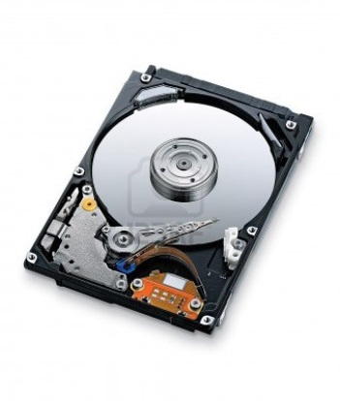
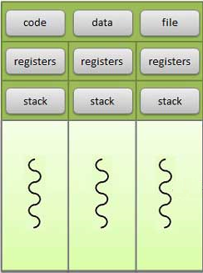
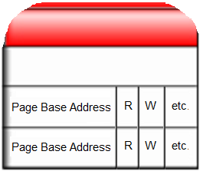
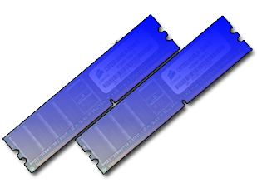
An interrupt by hardware!
MMU is a common component of commodity hardware
Process
Virtual Memory
By relying on the page-level mechanisms in MMU, we can prevent threads from accessing a memory page
Notes:
Let’s interrupt our discussion and switch the context for a while
All of you know about Memory Management Unit or MMU and Virtual memory organization
Each page table entry includes some protections bits
By relying …

Slide 10
A more sophisticated approach: Using page protection bits
Thread#1
Thread#2
Page Table
Physical Memory
PageBaseAddress
Read
Write
0x2FF8000
0
0
TX1
1
1
blocked
0x2FF8000
X=99
write(X)
blocked
X=10
TX2
read(X)
read(X)
For a given page, how can we give different permissions to different threads?
Notes:
Now we switch back to our previous discussion about direct reads.
By having in mind what I just told you about protection bits, we can take a more sophisticated approach
…
But how can we solve this problem?

Slide 11
Mapped memory
By using memory map functions, we can define different virtual memory regions with different protection levels
Thread#1
Thread#2
Page Table
Physical Memory
PageBaseAddress
Read
Write
read(X)
0x2FF8000
0
0
X=10
0x2FF8000
0x2FF8000
1
1
read(X)
[Abadi et al., ACM PPOPP’09]
Notes:
Lets take one more step ahead

Slide 12
Proof of concept: PGSTM
At most, one writer transaction at each time
Using a single global lock
Multiple read-only transactions can at each time
Read-only transactions can execute in parallel, as long as they do not read from pages being written
Notes:
As a proof of concept we started with the simplest stm we could think of
In PGSTM …

Slide 13
PGSTM’s Memory Model
Two different virtual memory regions pointed at same physical memory pages
Read-only Region contains either read-only or inaccessible pages
In Read/Write region all pages are accessible and updatable
Page Table
Physical Memory
Read-only region
Shared Data
Read/Write region
Notes:
PGSTM uses mapped memory technique I just showed to you
As there are only two different access levels we define two different memory regions

Slide 14
PGSTM in action
Thread#1
Thread#2
Page Table
Physical Memory
PageBaseAddress
Read
Write
0x2FF8000
1
1
TX1
0
0
blocked
0x2FF8000
X=99
write(X)
X=10
0x2FF8000
1
1
TX2
read(X)
read(X)

Slide 15
When to unlock a page?
Can we unlock the page when the writer commits?
It is not safe if there are other active read-only transactions running
Unlock only after such active transactions complete

Slide 16
Evaluation environment
List look-up benchmark
Read-only transactions search for a random element
Read/Write transactions modify a random element
We compare our results with TML [Dalessandro et al.,Europar’10]
Notes:
TML:
At most one writer at each time
When writer active, no read/only tx can run
Lowest read overhead
To evaluate PGSTM we used a trivial list look-up benchmark
In which a read only transaction searches for a random element
And a read write transaction modifies a random element in the list
We also compare our results with results of TML which is a simple multi-reader/single writer stm
And to the best of our knowledge, has the lowest sequential overhead amongst state of the art stms

Slide 17
TML: Transactional Mutex Locks
At most, one writer transaction at each time
Using a single global lock
Read-only transactions can not run in parallel with the writer transaction
With the lowest sequential overhead

Slide 18
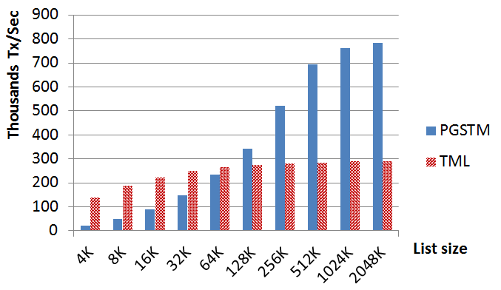
Evaluation: Different contentions
Less contention
Throughput for different contention levels
[64 threads, 10% write-load]
Notes:
In this chart, we see the throughput of PGSTM with different contention levels with 64 parallel threads and 10% of write load
We change the contention level by increasing the number of elements in list and the used memory by the list
We see that for the list size of 4kilobytes, which is the size of the page, we have very bad results.
This comes from the fact that most of the times read-only transactions face locked pages and have to back-off which is a costly operation
But as we increase the list size, we see at a certain point PGSTM starts outperforming TML.
The main reason behind this behavior is: in PGSTM, read-only transactions can commit in parallel with a writer transaction, as long as they don’t conflict with the writer transaction in terms of accessed pages, but in TML they can’t.

Slide 19
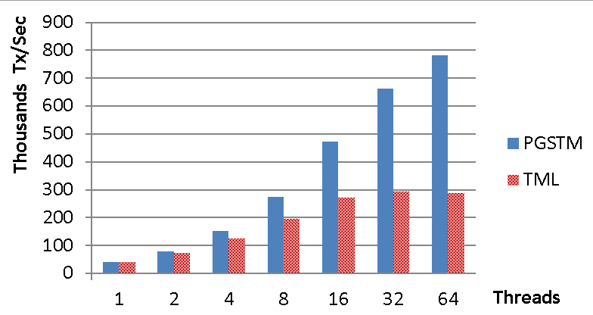
Evaluation: Scalability
Throughput for different number of concurrent threads
[2MB List, 10% write-load]
Notes:
In this chart we see how scalable is PGSTM.
We see as we increase the number of parallel threads, PGSTM scales better than TML.
This again comes from the fact that PGSTM allows read only transactions commit in parallel with writer transactions as long as they don’t conflict in accessed pages
but TML does not allow that.

Slide 20
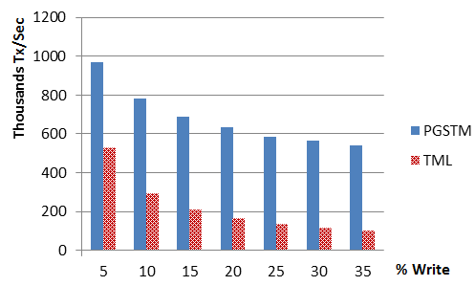
Evaluation: Different write loads
Throughput for different write loads
[2MB List, 64 threads]
Notes:
And in the last chart, we see how PGSTM behaves as we increase the percentage of writer threads from 5 percent to 35 percent
As you can see, PGSTM is almost two times faster than TML with 5% of writer. load
But this ratio increases to almost 5 for 35 percent of writer load
Which means PGSTM is more resilient to higher write loads comparing with TML

Slide 21
Conclusion
Using MMU with STMs can lower their sequential overhead
We proposed PGTSM as proof of concept
PGSTM outperforms TML in low contention scenarios
Our preliminary results are promising
Notes:
As a brief conclusion , in this work
We studied the feasibility of using page protection features in memory management unit to decrease the sequential overhead of STM.
Toward this end, we proposed PGSTM and evaluated it
And Our first results with PGSTM show the proposed model can reduce the sequential overhead of STM

Slide 22
Future works
Evaluating with non-trivial benchmarks
Supporting multiple writers
Using finer grained conflict detection
Upgrading to a generic accelerator layer that runs on top of any STM
Notes:
In future we want to add support of multiple writers to PGSTM
And benchmark it with well-known STM benchmark suites such as STMBench7 or STAMP
At the end, we intend to extend this work to a generic approach to boos the sequential performance of any STM

Slide 23
Thank you!
Notes:
Thank you for your attention

