Slide 1
Yaroslav Hayduk, Anita Sobe, Pascal Felber University of Neuchâtel, Switzerland
Dynamic Parallel Message Processing with Transactional Memory in the Actor Model
DMTM
January 22, 2014

Slide 2
A bit of background: The Actor Model
Hewitt & Baker (IFIP Congress’77) – „Laws for Communicating Parallel Processes“
Motivated by the prospect of highly parallel computing machines with many microprocessors + own local memory

Slide 3
OOP and actors
Everything is an actor (VS an object)
Asynchronous message passing
Has access to its local state only
Strong encapsulation
Inherently concurrent

Slide 4
OOP and actors: Communication
Object A
ObjectB.publicMethod()
ObjectB.publicField=10
Object B
direct access
Illegal: strong encapsulation
VS
ActorB.publicField = 10
ActorA [SendMessageTo] ActorB
Object A
Object A
asynchronous message passing

Slide 5
Problem statement
Sequential processing of messages limits performance & throughput
Concurrent message processing using STM (Hayduk et al., OPODIS 2013)
is NOT optimal in cases of high contention

Slide 6
Main contributions
We propose to
adapt the number of threads to the workload
extract read-only messages from the transactional context
Notes:
If consistency is not required

Slide 7
Concurrent message processing
Actor C (“List” Actor)
B
Local Actor state
Contains 2
2
5
6
8
9
In progress:
Contains 8
……
In progress:
Insert 8
Remove 9
A
Thread Pool
Active threads
Problems in the case of high contention?

Slide 8
Idea 1: Dynamically adjust the # of threads
Actor C (“List” Actor)
B
Local Actor state
Contains 2
2
5
6
8
9
In progress:
Contains 8
……
In progress:
Insert 8
Remove 9
A
Thread Pool
Active threads
Idle resources

Slide 9
Idea 1: Dynamically adjust the # of threads
Use a simple heuristic
Measure the
If decrease the thread count, otherwise – increase it

Slide 10
Idea 2: Use idle threads for relaxed operations
Can we exploit the idle resources?
Use them for specific read-only operations operations with relaxed atomicity and isolation semantics!

Slide 11
Example: List Actor operations
Actor
Insert/
Remove/Contains
Messages
Very these depending on
private listData=Ref(data)
Relaxed sum
…..
Messages

Slide 12
Modified Scala STM
Ref object methods:
get()
….
relaxedGet()
….
Transaction Scopes:
atomic{}
atomic.unrecorded{}
Ref
volatile protected_data
Our singleRelaxedGet() operation
Since it’s a write-back STM,
we can safely access the value directly
Notes:
relaxedGet/atomic.unrecorded{} clash with transactional operations

Slide 13
Idea 2: Use idle threads for relaxed consist. task
B
Actor C (“List” Actor)
Contains 2
Local Actor state
2
5
6
8
9
In progress:
Contains 8
…
In progress:
Inconsistent Sum
Remove 9
A
Thread Pool
Relaxed consist. Threads
TM Threads

Slide 14
Experimental settings
Software: Scala 2.12 & Akka 2.10 & ScalaSTM 0.7
Hardware: 48-core AMD Opteron 6172 CPUs running at 2.1GHz

Slide 15
Evaluation: Application overview
1) Stateful distributed sorted integer linked-list
A List Range (1..25) Actor
……….
A List Range (100..125) Actor
Global relaxed list sum
TM Insert/Remove/Contains
A
B

Slide 16
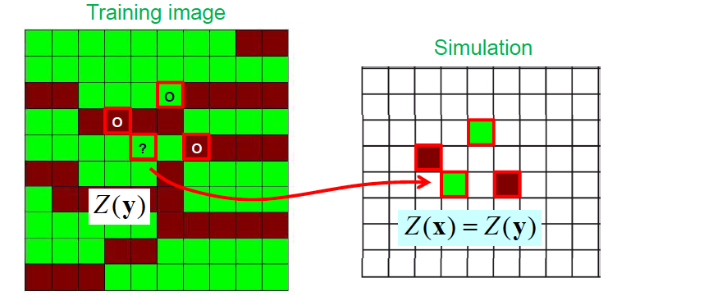
Evaluation: Application overview
2) Multiple-point geostatistics application (Hydra)
When found, assign the value Z(y)
to the simulation grid

Slide 17
2) The Multiple-point geostatistics application
Actor
Simulation
Messages
private grid=Ref(data)
Snapshot
Messages

Slide 18
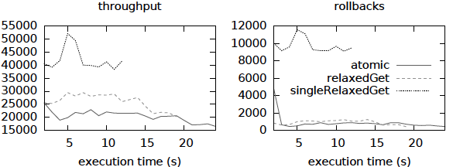
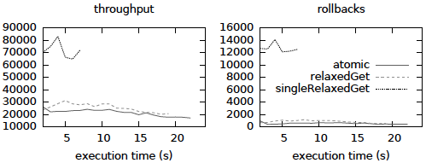
Results – list benchmark
List write-dominated workload: static thread allocation.
More write-write conflicts
resolved by killing one txn
more read-write conflicts,
which are resolved by
waiting
List write-dominated workload: dynamic thread allocation.
Notes:
Not only we managed to get higher throughput but lowered the execution time
singleRelaxedGet proposed by us performs substantially better than ScalaSTM alternatives
HIGHERED ROLLBACKS!

Slide 19
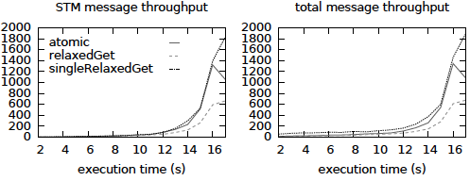
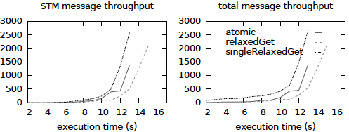
Results – Hydra
Static thread allocation; STM message throughput and total message throughput.
Static ratio
3 Read-only threads
29 TM threads
Dynamic thread allocation; STM message throughput and total message throughput.
Notes:
In the Hydra app case we also reduced the execution time and increased throughput
IDEA 1 – LOWERED ROLLBACKS

Slide 20
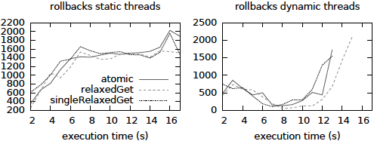
Results – Hydra
Simulation of the hydraulic subsurface: static and dynamic thread allocation; rollbacks.
Static ratio
3 Read-only threads
29 TM threads
Benefits of varying the TM thread count
Notes:
A simple heuristic substantially reduced rollbacks
More advanced heuristics could further minimize rollback #’s

Slide 21
Summary
By dynamically varying the number of threads, we increased the Actor message throughput;
used idle resources for relaxed consistency operations;
the combination of both approaches yields the best performance

Slide 22
Questions?

