Slide 1
Highly parallel programming with Transactional Memory
Ricardo Filipe
João Barreto

Slide 2
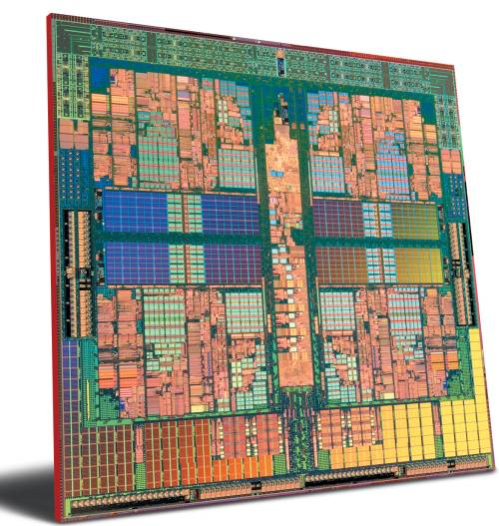
Motivation
Multicore architectures are the norm
Manycores are on their way

Slide 3
Why parallel programming is hard
TM simplifies the task of synchronizing critical sections

Slide 4
Why parallel programming is hard
TM simplifies the task of synchronizing critical sections
…But forking code into threads is still hard

Slide 5
Challenges of forking threads
Forking a TM thread inccurs creation and management overheads

Slide 6
Challenges of forking threads
Forking a TM thread inccurs creation and management overheads
TM threads must be commutative

Slide 7
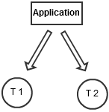
Usually we have more available cores than application threads…
2 Threads
4+ Cores...

Slide 8
Is there any parallelism hidden inside each thread that the programmer forks?

Slide 9
Motivational results
RBTree – “contains” op, 1 TM thread, 2 TLS threads

Slide 10
Motivational results
STMBench7 – long Txs, 1 TM thread, 3 TLS threads

Slide 11
How do we explore intra-thread parallelism?

Slide 12
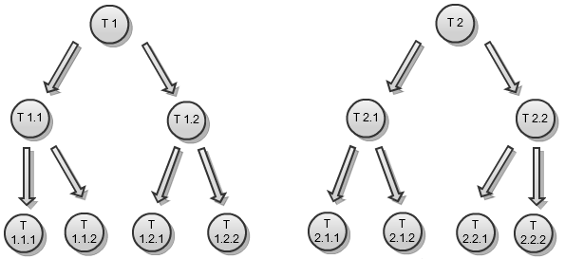
I’m awesome! Divided my application into more TM threads!

Slide 13
Nested Transactional Memory
Inner TM threads don’t run in parallel efficiently
Hinders expert programmers and libraries designed to run in TM

Slide 14
Parallel Nested TM: NepalTM
“Solving parallel nested transactions is complex and its efficient implementation appears to be questionable”

Slide 15
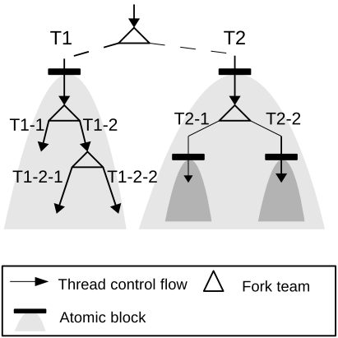
Parallel Nested TM: NepalTM
First level of threads is managed with TM
Deep nesting levels use mutual exclusion locks

Slide 16
Parallel Nested TM: XCilk
Gives a provable performance guarantee for conflict free write-only TM parallel nested applications

Slide 17
Parallel Nested TM: XCilk
Gives a provable performance guarantee for conflict free write-only TM parallel nested apps
Introduces Lemma for conflicts in parallel nested TMs:

Slide 18
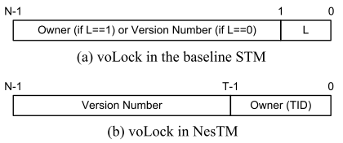
Parallel Nested TM: NesTM
Each version owner lock now has owner information always present for ancestor query
Uses a list to validate the ancestors read-sets on each write

Slide 19
Parallel Nested TM: NesTM
Each version owner lock now has owner information always present for ancestor query
Uses a list to validate the ancestors read-sets on each write

Slide 20
Undesirable features
Visible reads
Linear overhead
All operations are “writes”

Slide 21
I’m not that good... Help!

Slide 22
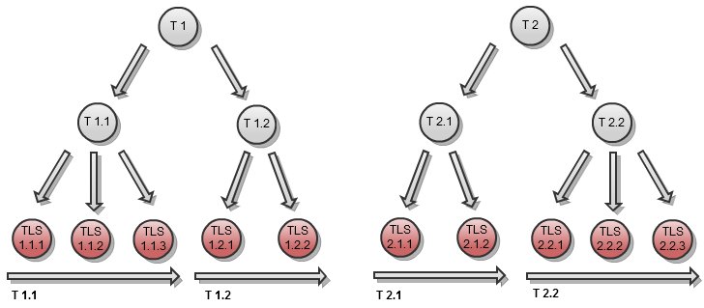
Thread Level Speculation does some work for you

Slide 23
Challenges of TLS
Non-optimal automatic code division

Slide 24
Challenges of TLS
Non-optimal automatic code division
Mirror sequential code execution

Slide 25
Challenges of TLS
Non-optimal automatic code division
Mirror sequential code execution
Trashes TM when simply used on top of it

Slide 26
Thread Level Speculation
In-Place Write Commit Approaches
Each task commits when it ends
Rollback goes to the task before the conflict

Slide 27
Thread Level Speculation
Serial Write Commit Approaches
Last task of the thread commits all writes
“Future tasks” can be waiting some time

Slide 28
Conclusions: So much untapped parallelism!
Solve the problem of parallel nested transactions efficiently
Solve Thread Level Speculation on top of Transactional Memory adequately

Slide 29
Questions?
rfilipe@gsd.inesc-id.pt
www.gsd.inesc-id.pt

